Slide 1
11.11 Meeting - 6
吳定洋
1

Slide 2

Table of contents
01
02
One-side RTT (only smartphone support 802.11)
RTT position prediction experiment
03
Next Step
2

Slide 3

01
One-side RTT
3

Slide 4
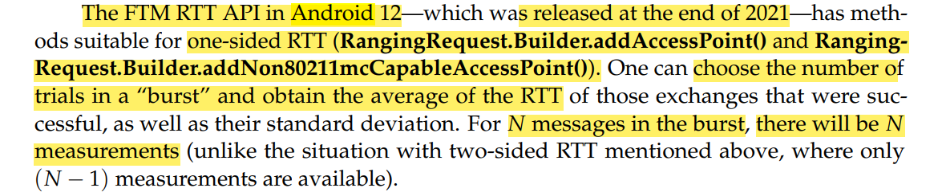
Paper Research
How I figure out one-side RTT concept?
Reference: Horn, B.K.P. Indoor Localization Using Uncooperative Wi-Fi Access Points. Sensors 2022, 22, 3091. https://doi.org/10.3390/s22083091
4

Slide 5
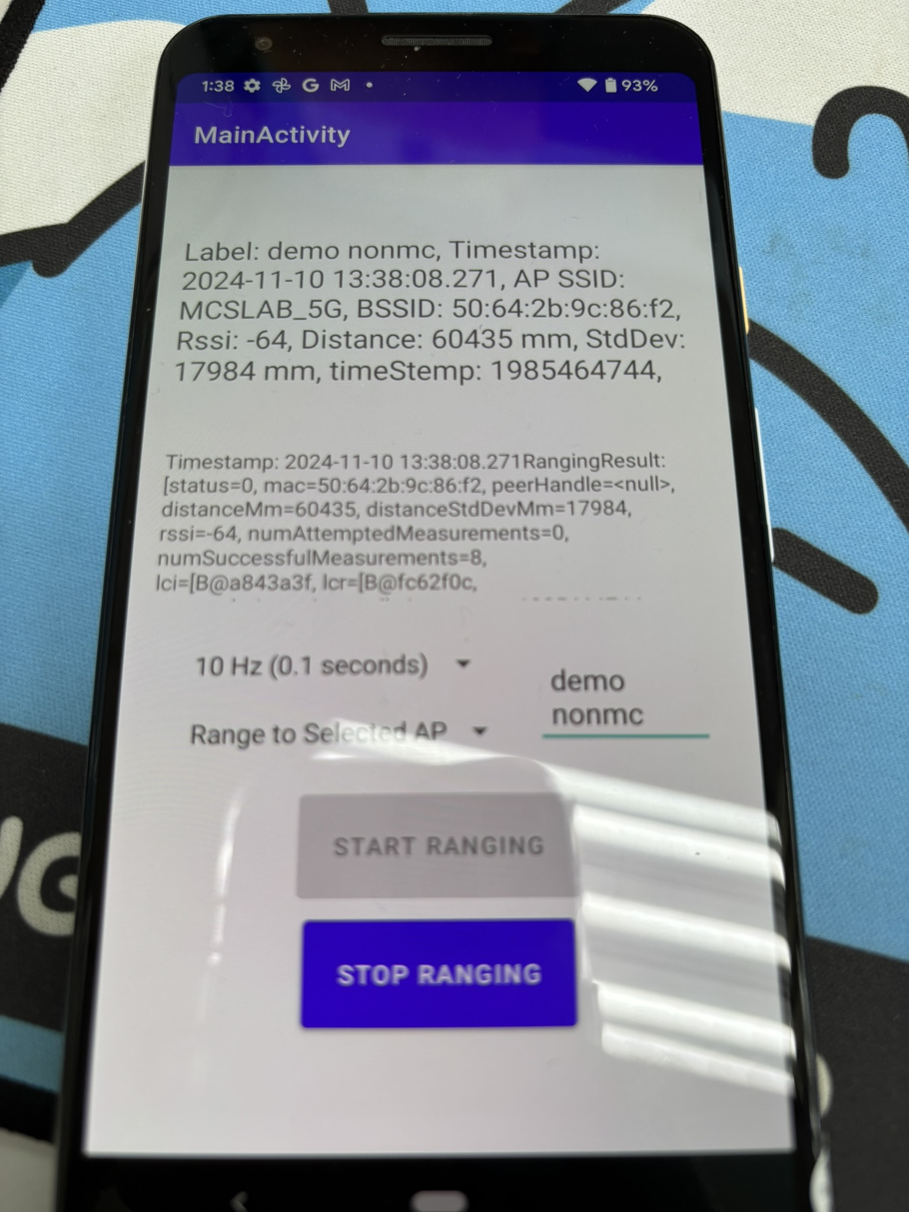
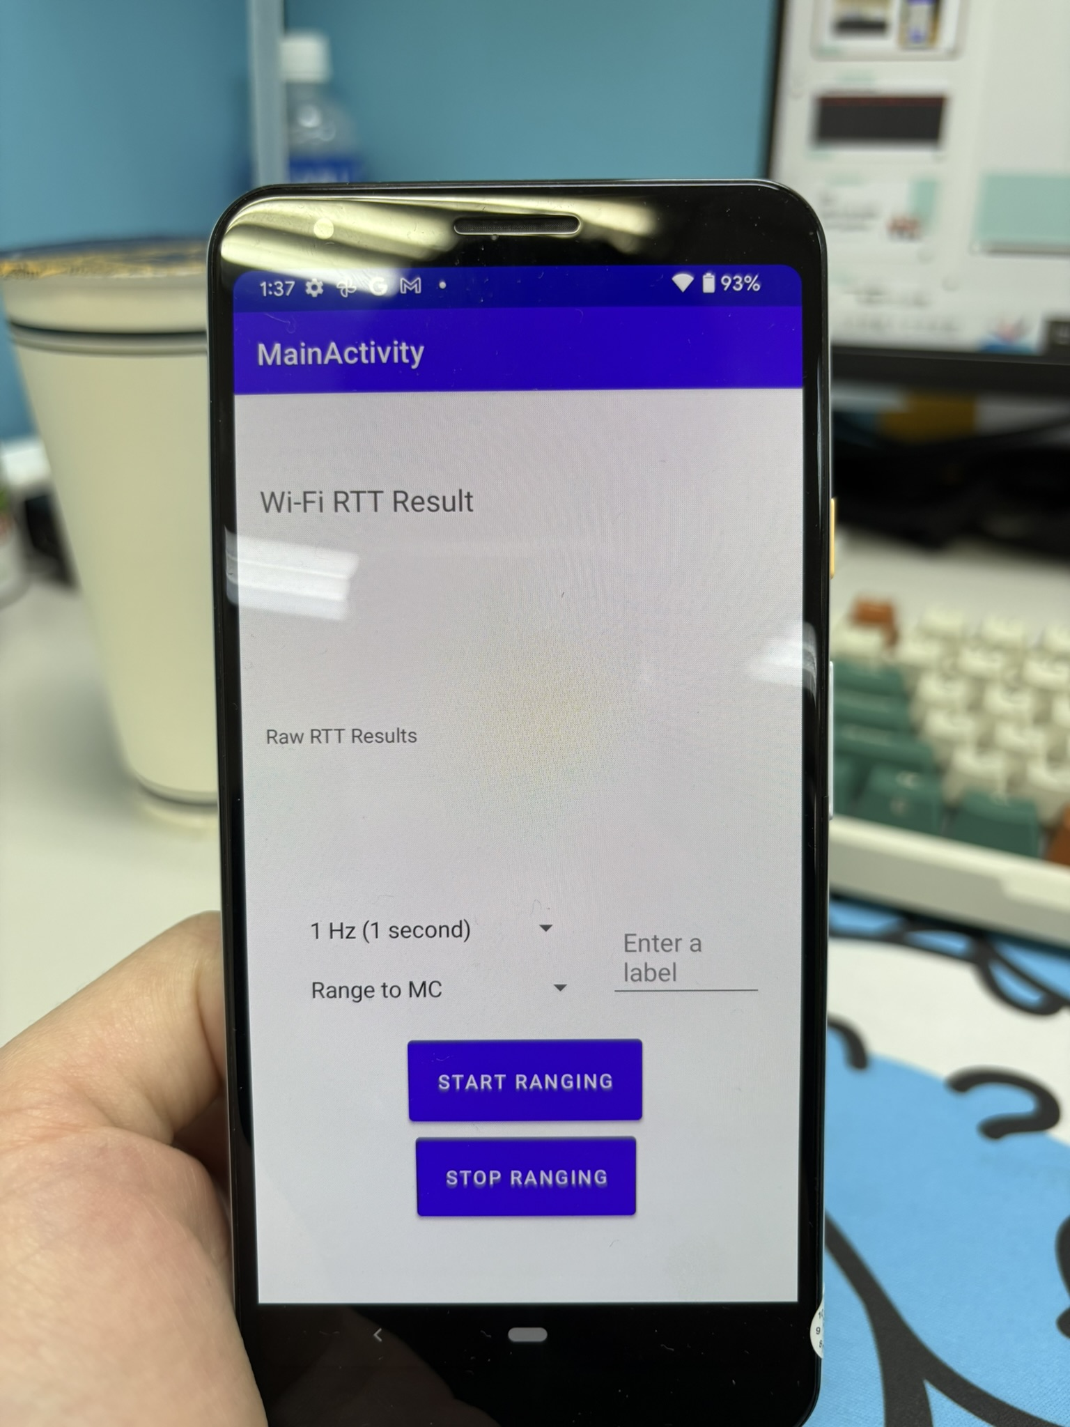
APP development and data collect
5

Slide 6
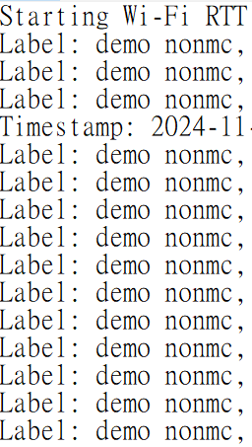
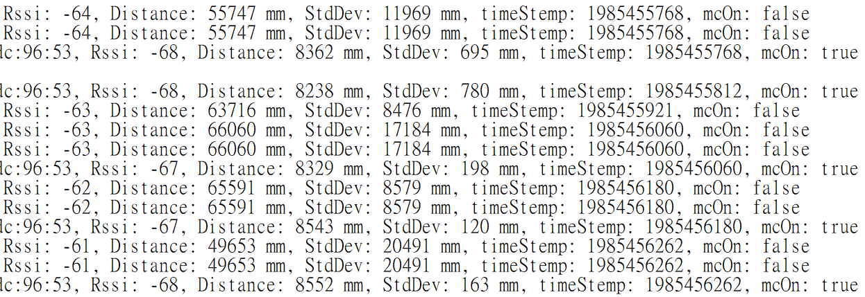
APP development and data collect
…
One-side RTT is far from accurate
6

Slide 7

02
RTT position prediction experiment
7

Slide 8
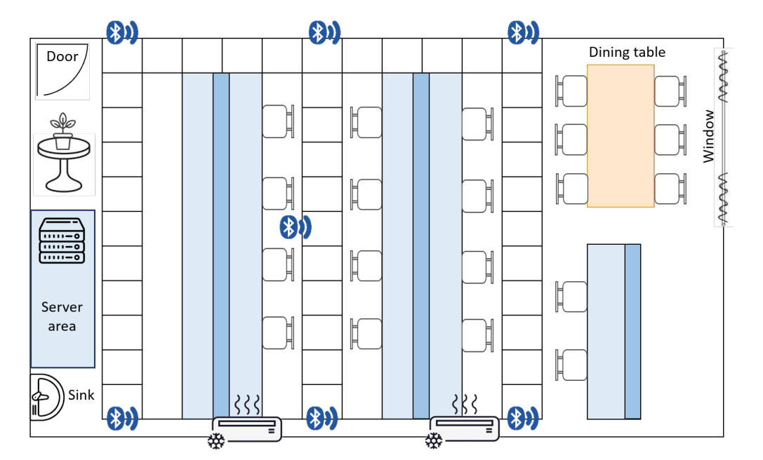
Experiment environment setup
A
B
C
Reference point : 60 cm * 60cm a grid
Wi-Fi AP
8

Slide 9
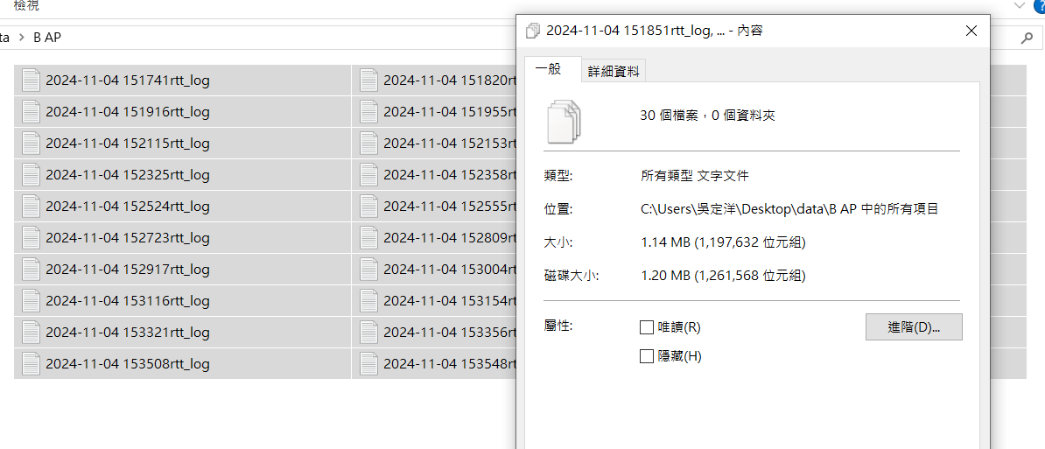

Experiment method
Half simulation : Using ONE AP at a time
Data collection : In every RP (total 30), collect 15 to 20 second RTT data, repeat 3 time for 3 AP position
9

Slide 10
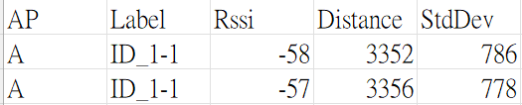
Data processing
Extract only the AP ID, Label, Rssi, Distance(RTT), StdDev data to a csv. File
Calculate the average distance for this RP
Extract the 100 data points closest to the average distance.
Overlay data from three different AP placement configurations
After step1.
After step4.
10

Slide 11
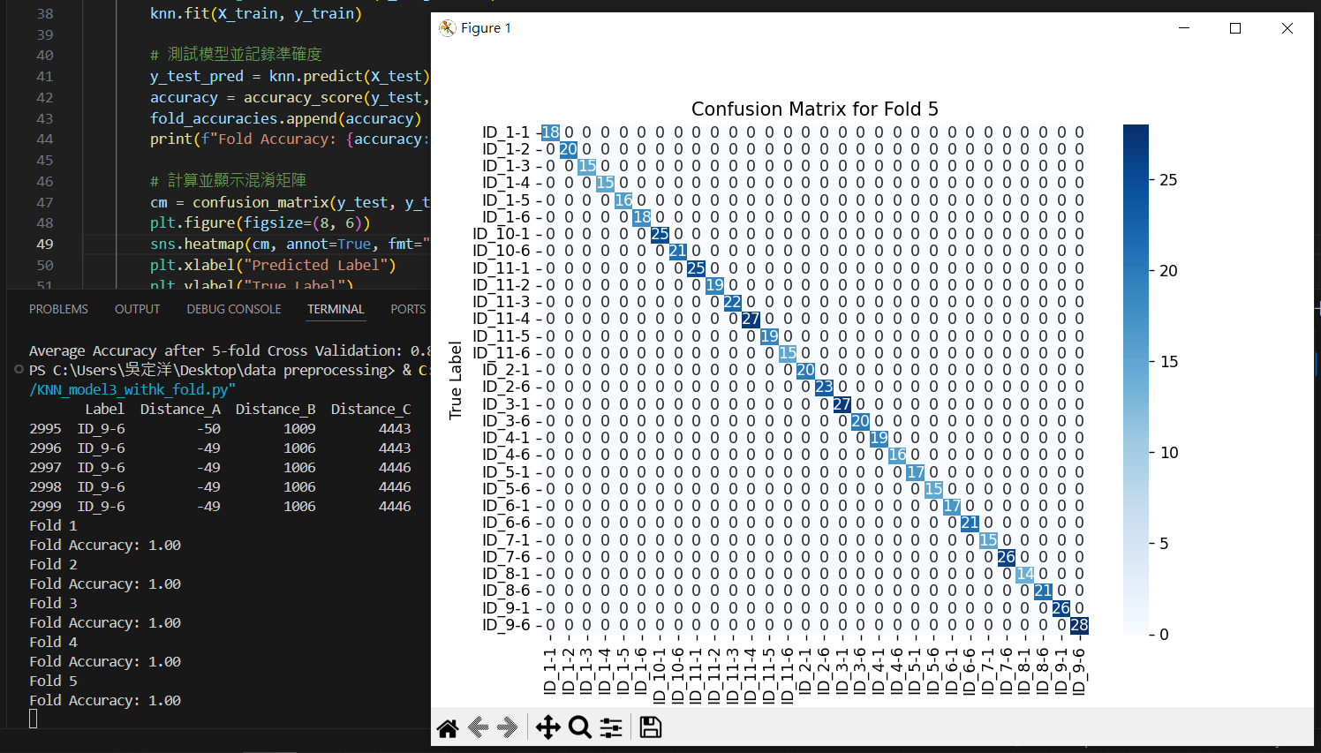
KNN model training
Using Wi-Fi RTTs as training data
Average Accuracy after 5-fold Cross Validation: 1.00
11

Slide 12
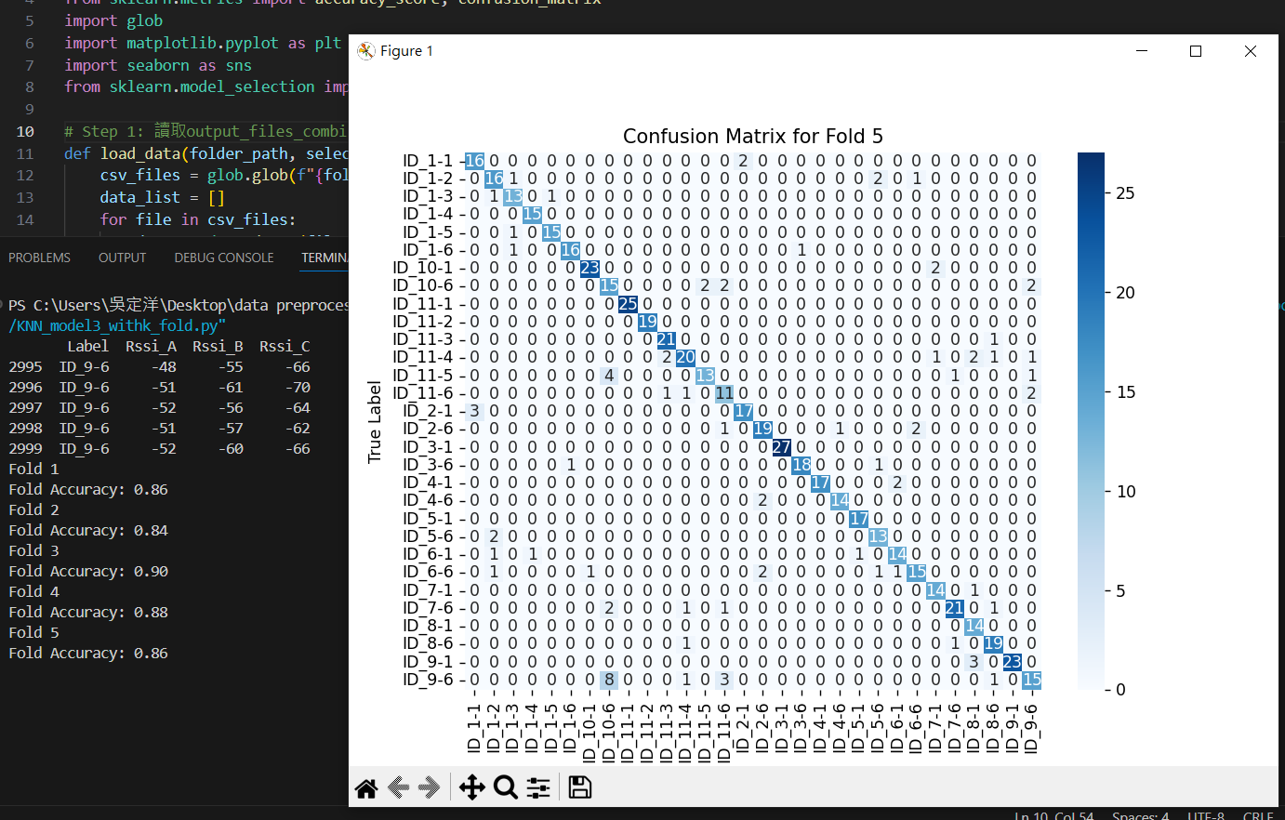
KNN model training
Using Wi-Fi RSSIs as training data
Average Accuracy after 5-fold Cross Validation: 0.87
12

Slide 13

03
Next Step
13

Slide 14
1. Buy 2 more AP and 2 long internet line 2. Try experiment on more NLOS conditions 3. Try Triangulation method instead of fingerprint
15

Slide 15

Thanks for Listening!
13

Slide 16

16

